Slide 1
Can I Stay Independent? Yes, MAKE It Happen!
Cameron M. Cox, III, MHA, FACMPE
Coronis Health
Chapel Hill, NC

Slide 2
Learning Objectives
Breakdown the obstacles and challenges for independent practices in the shift to value-based care models
Examine four essential areas for running an independent practice business
Compare new strategies to address significant issues in your practice

Slide 3
What does independence look like?
A state of being free of control
Exercising self government
Able to survive alone
Not having to depend on anyone or anything else

Slide 4
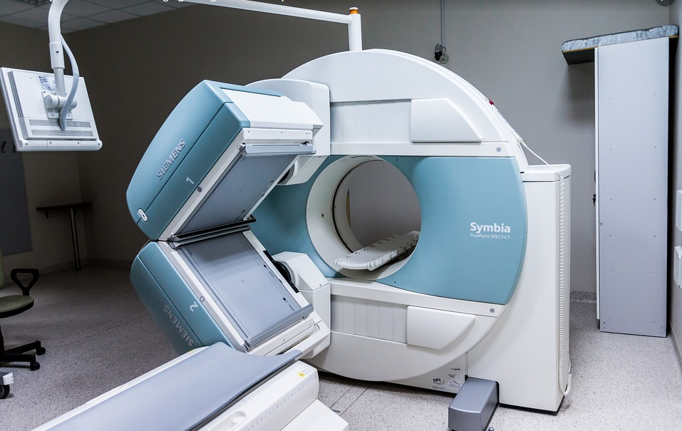
We’re not exactly like that…
Revenue can be limited
Services can be limited
Patients can be limited

Slide 5
The Trend is DEFINITELY not towards independence
Source: https://www.ama-assn.org/system/files/2019-07/prp-fewer-owners-benchmark-survey-2018.pdf

Slide 6
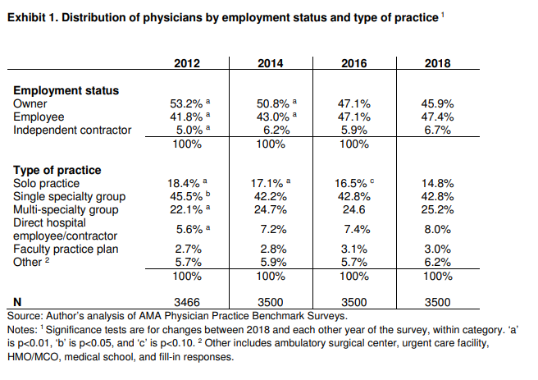
Some specifics over the last few years
Source: https://www.ama-assn.org/system/files/2019-07/prp-fewer-owners-benchmark-survey-2018.pdf

Slide 7
Let’s explore some of the obstacles to independence

Slide 8
Focus on Three Obstacles
Burnout
Competition Shift
“Business Savvy”
The study defines burnout as substantial symptoms of "emotional exhaustion, feelings of cynicism and detachment from work, and a low sense of personal accomplishment." This description tracks closely with the World Health Organization's newly updated definition for burnout.
Health systems
Telemedicine
Retail medicine
Urgent Care
Scope of practice shift NPs & PAs
keenness and quickness in understanding and dealing with a "business situation" (risks and opportunities) in a manner that is likely to lead to a good outcome.
Source: https://www.npr.org/sections/health-shots/2019/05/31/728334635/whats-doctor-burnout-costing-america
Source: Cameron Cox’s 25+ years of experience
Source: https://en.wikipedia.org/wiki/Business_acumen

Slide 9
Burnout Catalysts
Bureaucratic tasks
Work Hours
Lack of respect
EHRs
Compensation

Slide 10
The Shooting Gallery of Competition
Urgent Cares
Retail Clinics
Health Systems
Tele-
medicine
Mega
Groups

Slide 11
New World Order – Healthcare is a Business

Slide 12
So, let’s MAKE it happen!

Slide 13
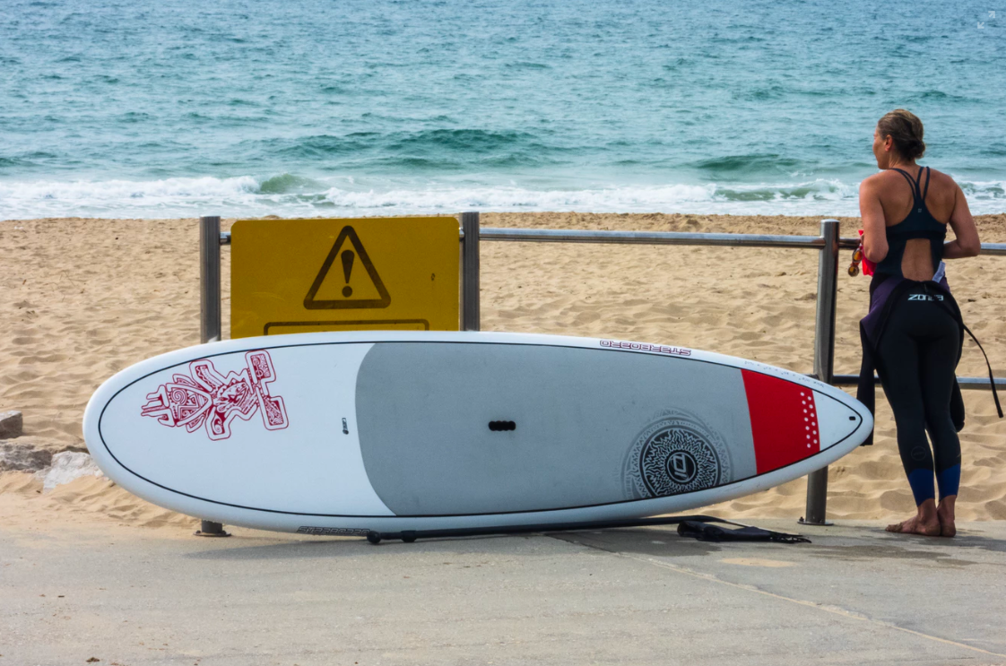
M is for Motivation

Slide 14
There was a time when getting an MD meant starting a practice…
The concept of acquiring a shingle and hanging outside a building is a bit outdated and certainly more difficult.
The challenges of patient control continue to be influenced by employers and insurance carriers….seemingly everyone but the patient.
Starting ANY business has been on a decline
Source: https://www.inc.com/magazine/201505/leigh%5C-buchanan/the%5C-vanishing%5C-startups%5C-in%5C-decline.html

Slide 15
M is for Motivated
Motivation is an important part of human psychology. It
arouses a person to act towards a desired goal.
It is a driving force which promotes action.
For example, hunger is a motivation which causes a desire to
eat. ... Motivation is the purpose or psychological cause of
an action.
To be motivated is to have purpose.
Source: https://simple.m.wikipedia.org/wiki/Motivation

Slide 16
A is for Anticipatory

Slide 17
A bit of a translation needed here…
….to be anticipatory means to be prepared for what’s next, what’s around the corner, what’s coming down the pipe
In other words, constantly thinking strategically.

Slide 18
We’re not exactly like that…
What do we do?
How do we do it?
For whom do we excel?

Slide 19
K is for Kinetic

Slide 20
A constant state of motion…
Constantly being critical
Constantly being creative
Constantly being confident
Constantly being decisive
Constantly being challenged
Constantly being good
Constantly being bad
Constantly being ...
…whatever it takes

Slide 21
No substitute for…
Cultivating the culture
Embracing Change
Solving the problem
The culture is where we can reinforce the what we do and how we do it.
The market is changing…everyday. As business owners, change is inevitable and should be constantly encouraged.
Solve the problem….even when sometimes we may be the problem. Critical thinking is an essential component to effective management of a problem.

Slide 22
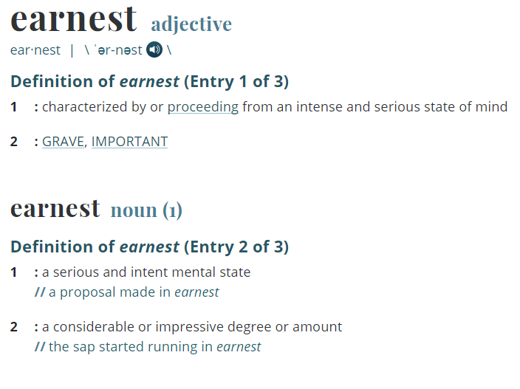
E is for Earnest
It really doesn’t matter if the definition is for the adjective or the noun.
Source: https://www.merriam-webster.com/dictionary/earnest

Slide 23
Healthcare is Hard

Slide 24
Just because it’s hard and it’s changing…. doesn’t mean it’s not worth doing…
Would you give up music?

Slide 25
Independence is not dead
Motivated
Anticipatory
Kinetic
Earnest
Owning a business in today’s environment is challenging. However, it can also be extremely rewarding. It is no longer as “simple” as it may have been in the past….but the recognition of steering one’s own ship still has value.

Slide 26
Questions?

Slide 27
Thank You
Thank You
Coronis Health
(877) 983-1234
5963 Exchange Dr Ste. 114,
Sykesville, MD 21784
www.coronishealth.com

