Slide 1
OK MGMA Fall 2021 (Lions and Tigers and Bears O MY!”)

Slide 2
HealthCare Operations and Technology: Way past due for an extreme makeover
Marion K. Jenkins, PhD, FHIMSS
Partner, HealthSpaces
303.918.8853
marion@healthspaces.com
More Info: “It’s time to break the mold: Healthcare operations and technology are
due for an extreme makeover”
MGMA CONNECTIONS INSIGHT ARTICLE - SEPTEMBER 22, 2021

Slide 3
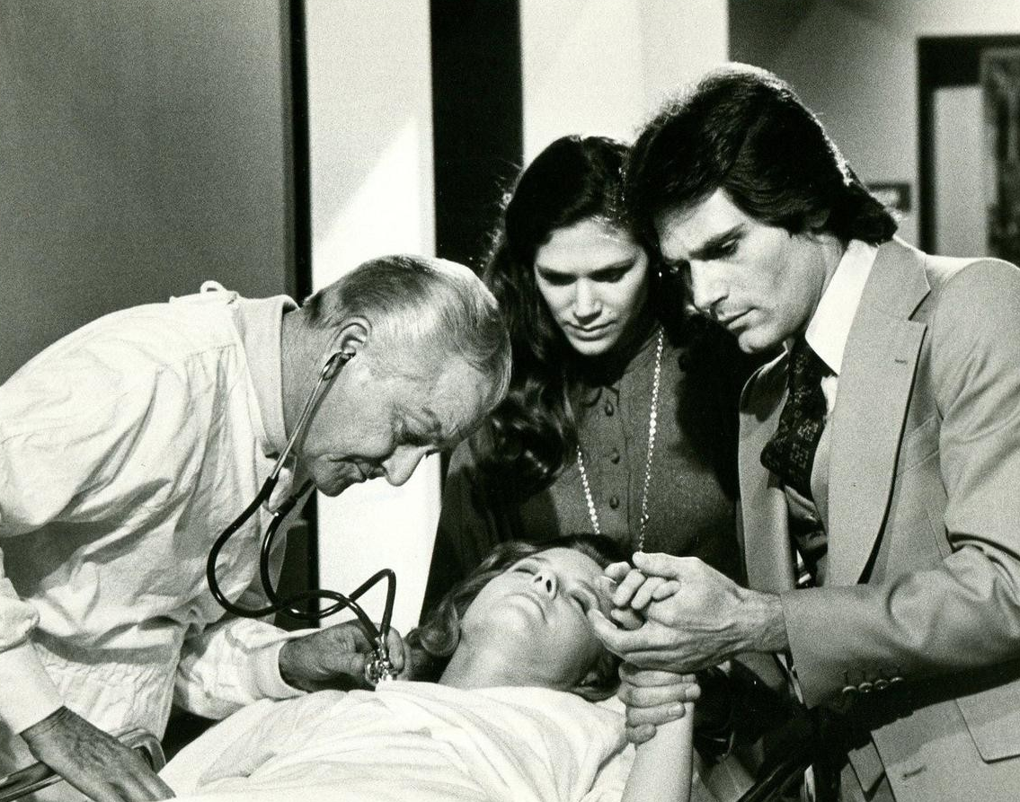
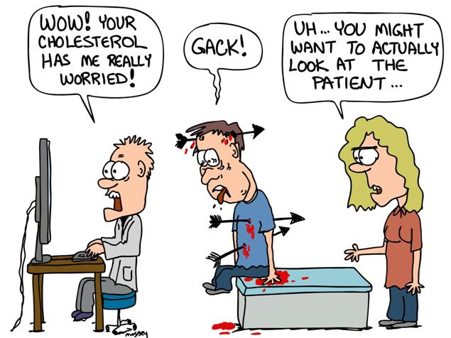
How did we get from here…
…to here?
Technology has made healthcare worse

Slide 4
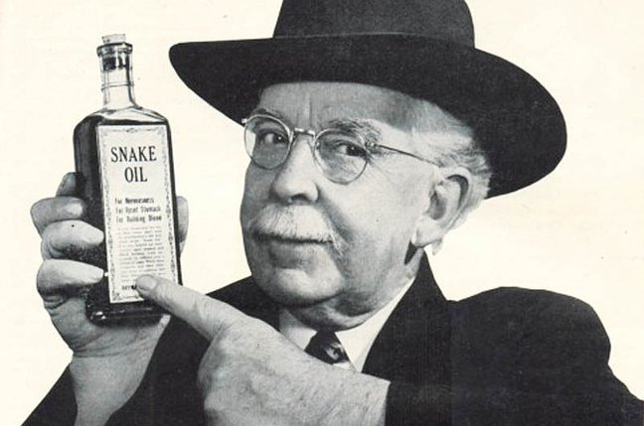
Healthcare Technology - the last ~decade:
(President of the AMA, Joseph L. Madara, MD, 2016)

Slide 5
~2009
The great and powerful EMR!

Slide 6
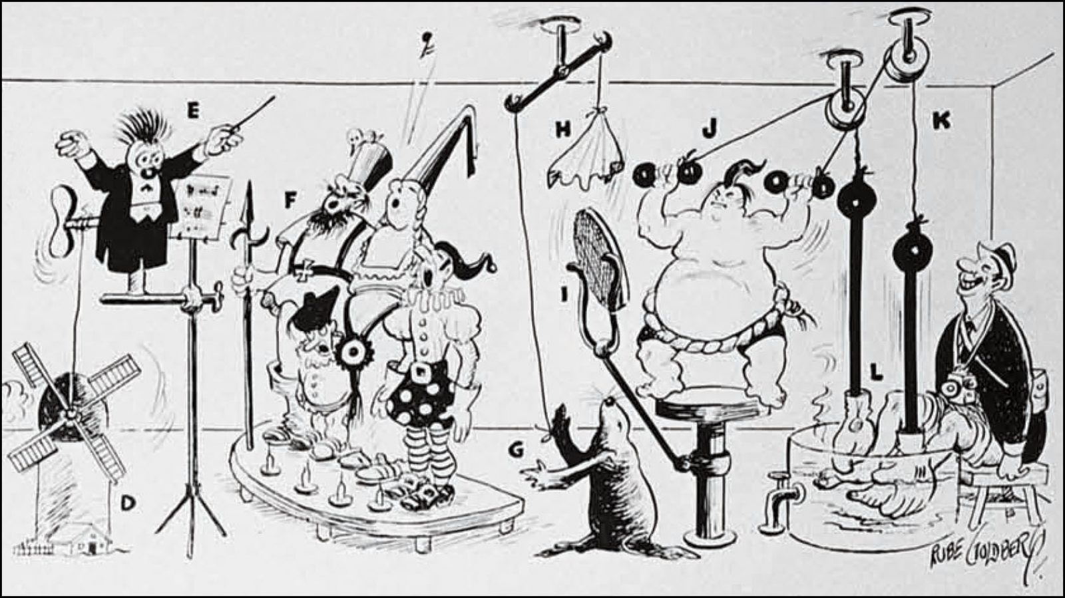
~Today
THE REALITY
Epic App Orchard and Athena Marketplace have 400+ add-on apps!

Slide 7
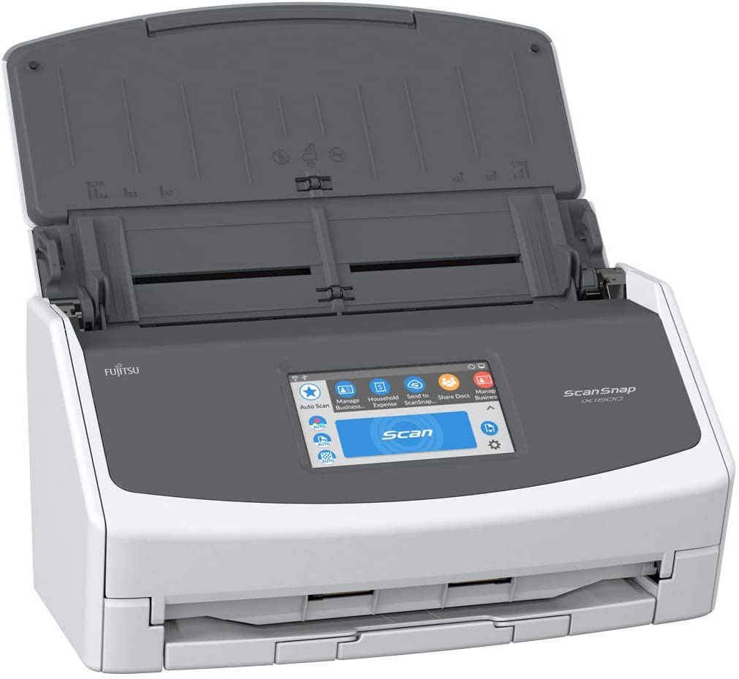
It all started with…
The “next thing”
Vaccination Status
COVID Screening
Patient Surveys
Sexual Orientation
MIPS/MACRA
Meaningful Use
Coding/Compliance
HIPAA/Disclosures
Paper health record

Slide 8
Kill off old/inefficient processes
Replace vendors with partners

Slide 9
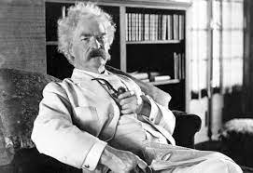
“Sacred Cows make the best Hamburger (Mark Twain)

Slide 10
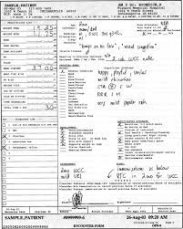
This is not data*…
*although it is technically “digital”

Slide 11
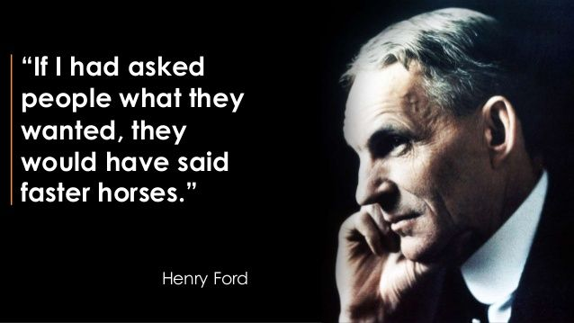
What if Amazon merely made shopping carts and cash registers work faster?

Slide 12
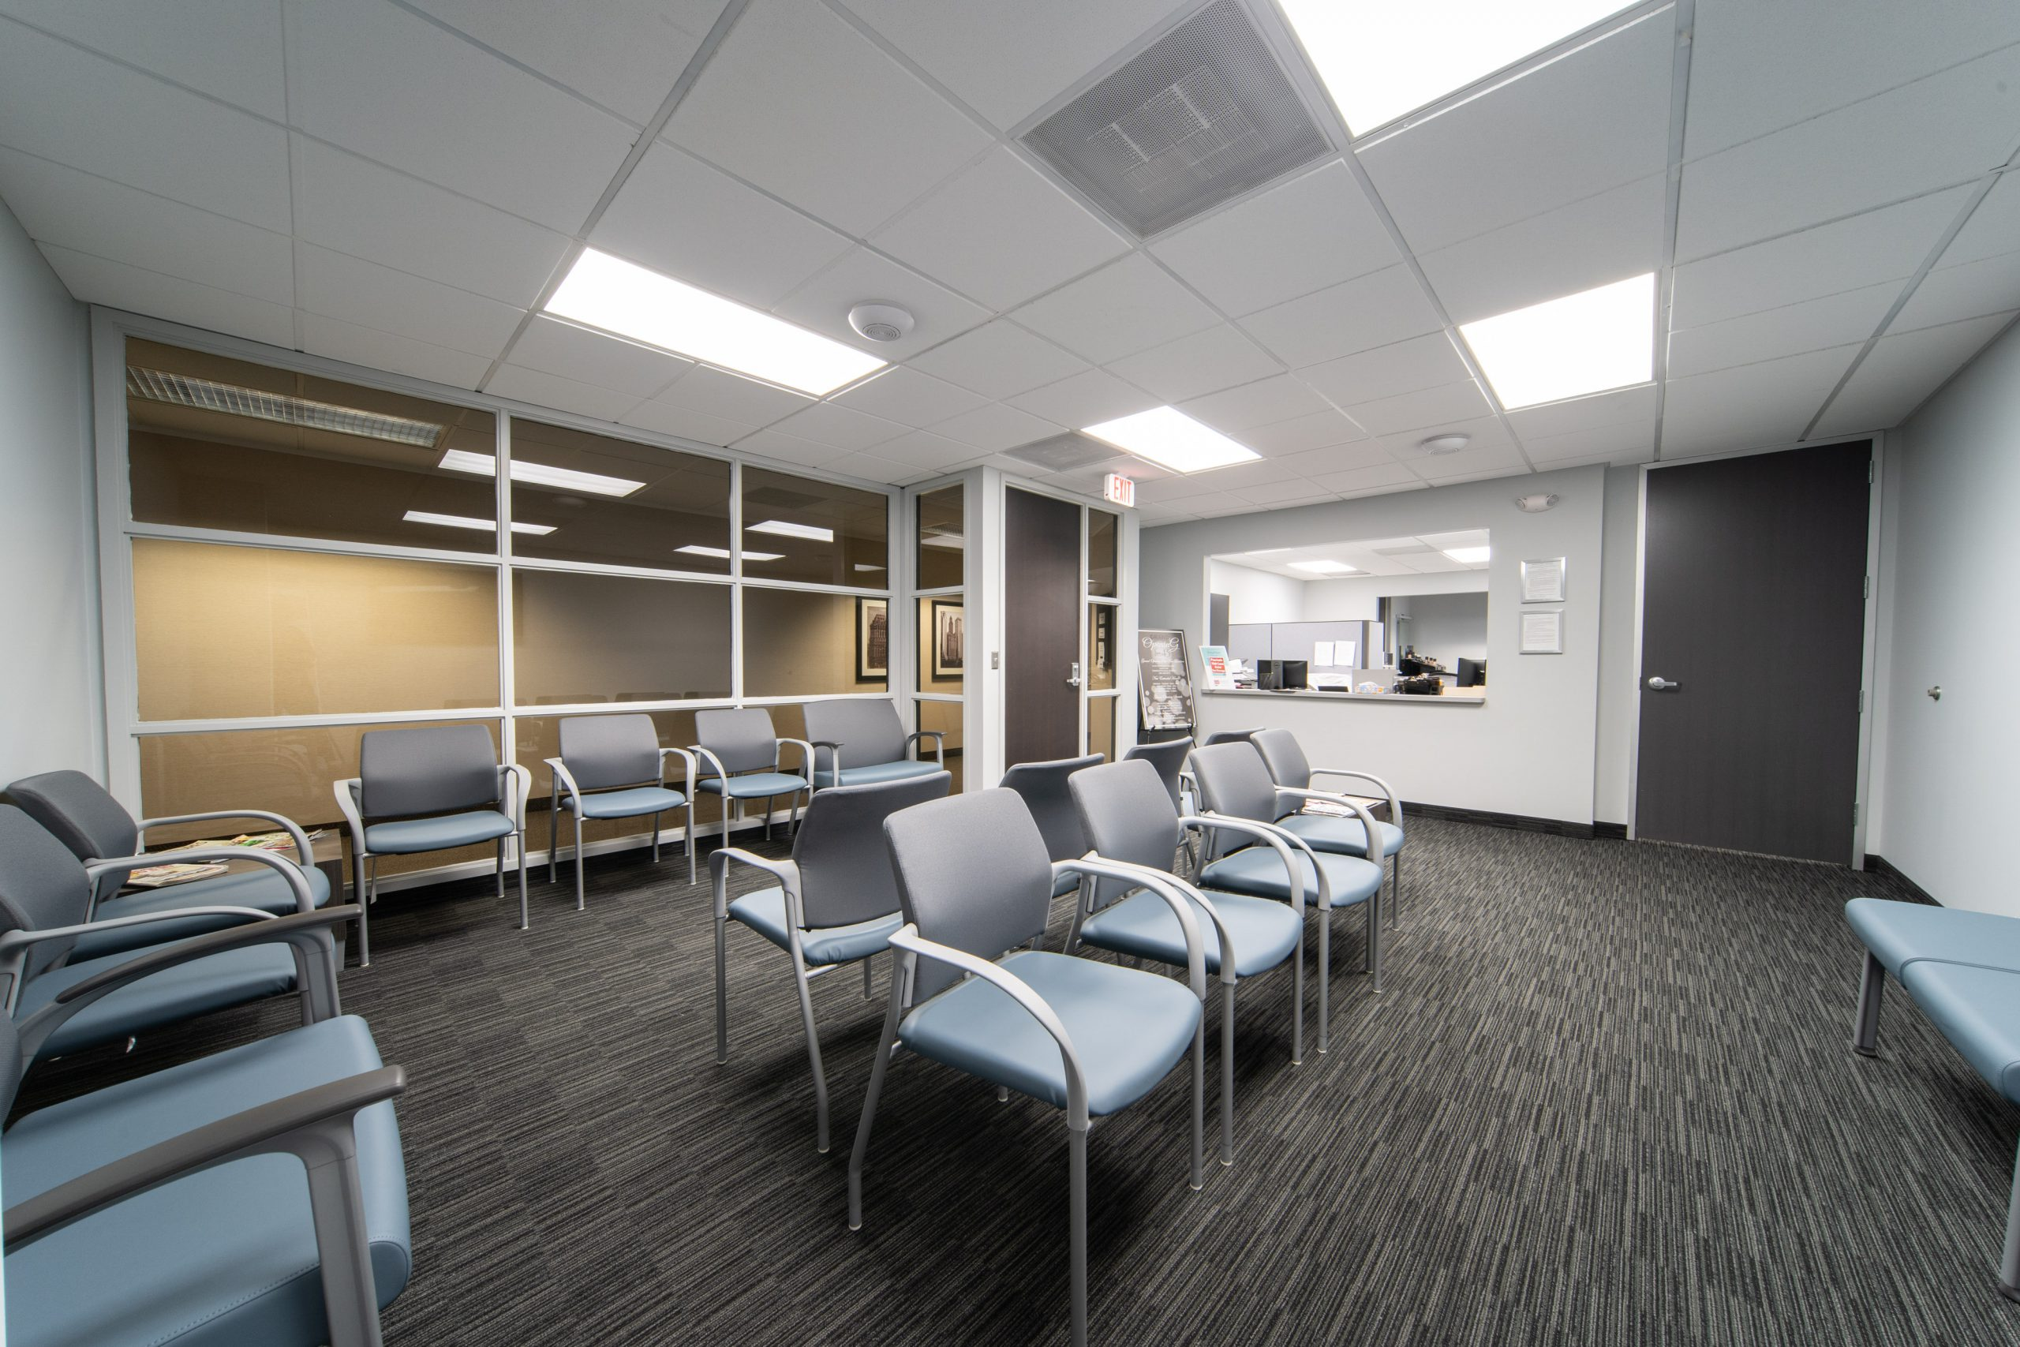
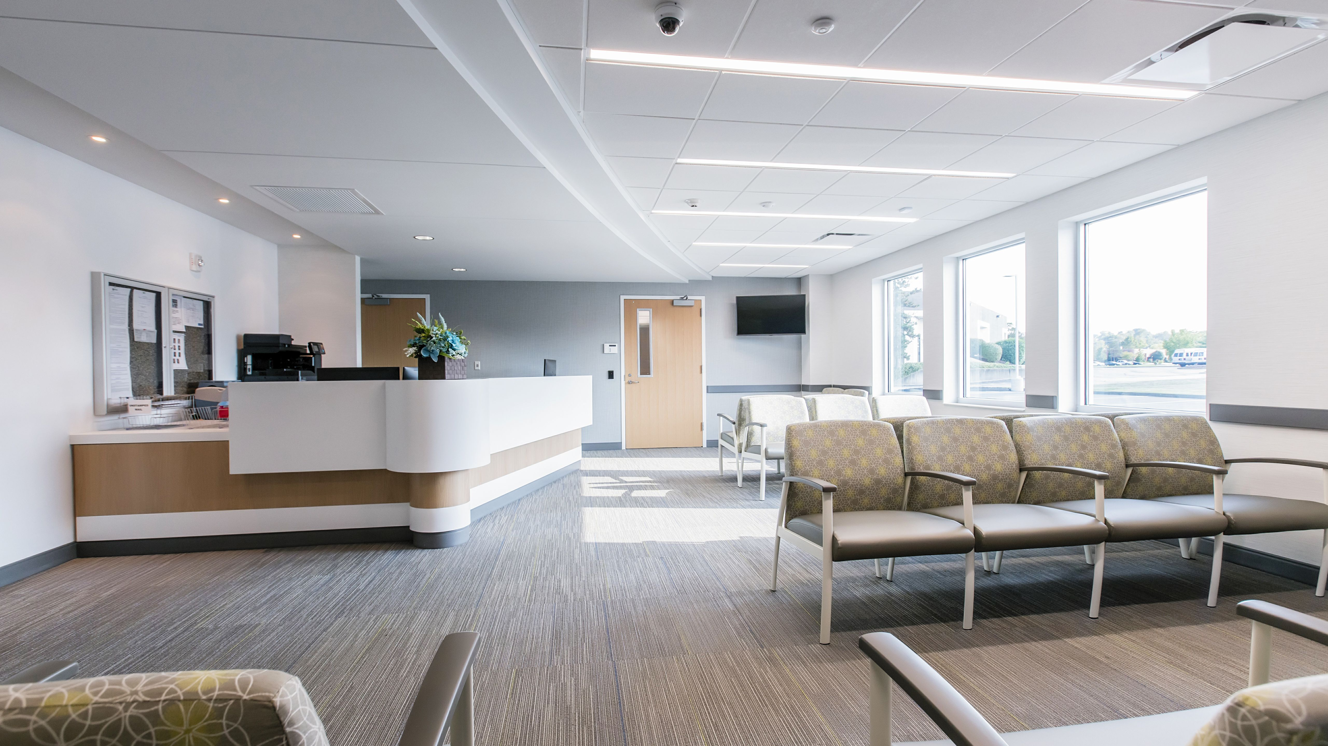

Slide 13
Let’s play a Game: “kill a process”
A fax or a form (or a photocopy thereof)
A physical file folder (even temporary)
An “inbox” or paper holder of some kind
An extra phone call or note/handoff to other(s)
Anything with the patient’s name/DOB etc.
Anything you end up shredding later

Slide 14
technology vision
Delight patients
Improve providers’ (and all staff’s) daily lives
Become a thought leader (patient view)
Quantum change/break from the past
Add value to the enterprise

Slide 15
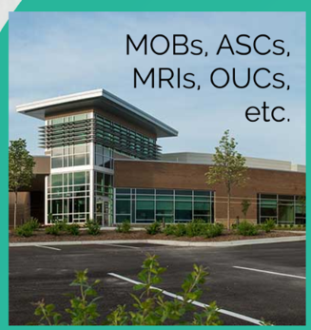
Build vs. buy
For technology, it’s build (own) versus buy (rent)

Slide 16
What things add value to your practice?
Add value
Facilities/infrastructure (own)
Training/Development
Business Optimization
Process Automation
Service lines (MRI, ASC, etc.)
Your own technology
DO NOT Add Value
Facilities/Infrastructure (rent)
Processes (forms/faxes)
Computer hardware
Software fees (inc SaaS)
Hiring more staff
More software products

Slide 17
Partner vs vendor
Partner:
Help develop systems for you
Allows you to invest in them
Goes at risk with you
Vendor:
Sells you a product
Locks you into a contract
Plays the “out of scope” game

Slide 18
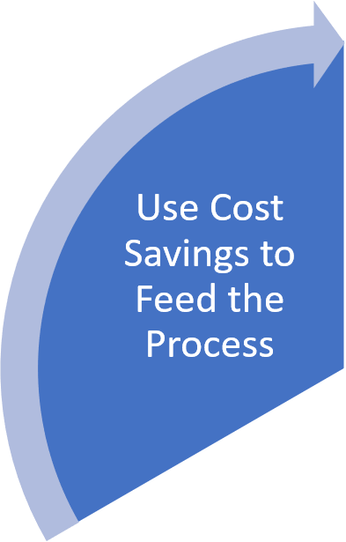
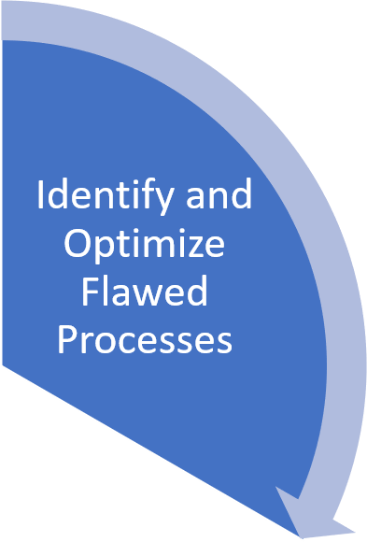
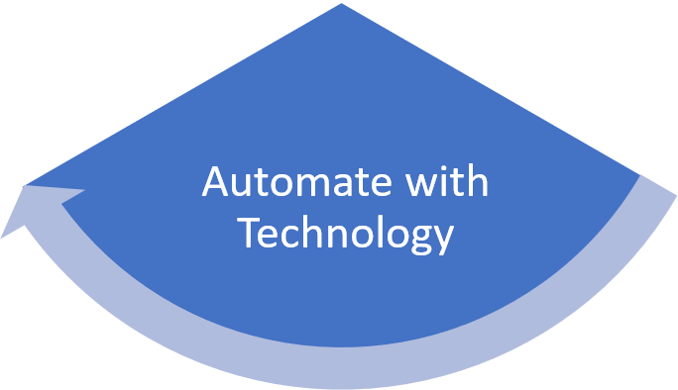
Virtuous “value” cycle
Optimize
before you
Automate
Small Steps
(no “big bang”)
Doesn’t mean a “product”

Slide 19
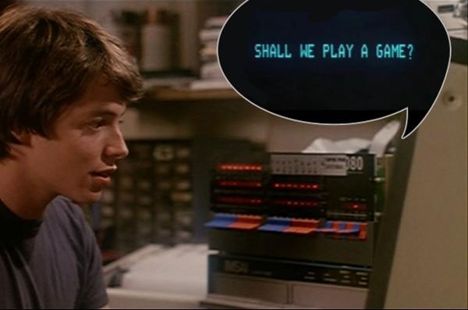
Let’s play a game: “dump a vendor”
Lengthy “scope” section (somebody call a lawyer!)
Onerous contract (multi year)
Constant change orders and SOWs
Every inquiry leads to a sales call
Multiple add-on products/vendors

Slide 20
Key Learnings
Use COVID (or any episode) to innovate
Invest in things that add real value
Break from past practices and approaches
Demand the right technology partnership
Continuously innovate to increase value

Slide 21
Thank You
Contact info
Marion Jenkins, PhD, FHIMSS
marion@healthspaces.com
303.918.8853
https://www.linkedin.com/in/marionjenkins
Some recent MGMA Connections Articles:
COVID and Technology – Time to innovate, not merely adapt
HIPAA – Don’t be a telehealth crash test dummy
The 21st Century Cures Act – After 10+ years of broken promises
Technology and operations – time for an extreme makeover
WHAT DO YOU THINK YOU ARE DOING, DAVE?

